Slide 1
RUNGTA COLLEGE OF DENTAL SCIENCES & RESEARCH
SEROLOGY
DEPARTMENT OF MICROBIOLOGY

Slide 2
Specific learning Objectives
At the end of this presentation the learner is expected to know ;
Core areas* | Domain ** | Category #
Ag – Ab reactions - Principles | Pschycomotor | Must know
Types of Reactions | Pschycomotor | Must know
Applications | Cognitive | Desired to know

Slide 3
Table of Content
Introduction
Theories
Types of Reactions
Applications

Slide 4
- the in vitro study of antigen-antibody reaction
- laboratory study of the activities of the components of blood serum that contributes to immunity

Slide 5
Preservation of Serum:
Physical - refrigerate for 72 hrs at 4-6ºC
Chemical - add 0.001g Merthiolate powder per ml serum or 5% phenol or tricresol at 0.1 ml/ml of serum
Inactivation of Serum:
Physical - heat serum at 56ºC for 30 minutes or heat at 60-62ºC for 3-4 minutes only.
Chemical - add choline chloride A

Slide 6
Immunological Reactions:
Primary - combination of Ag-Ab; non-visible reaction
Secondary - demonstrable Ag-Ab rxn (e.g. precipitation, agglutination)
Tertiary - immunologically in vivo; biologic rxn is detectable (e.g.phagocytosis, opsonization, chemotaxis)

Slide 7
Antigen-Antibody interactions
Characterized as:
Non-covalent interaction (similar to “lock and key” fit of enzyme-substrate)
Does not lead to irreversible alteration of Ag or Ab
This exact and specific interaction has led to many immunological assays used to:
detect Ag or Ab
diagnose disease
measure magnitude of humoral IR
identify molecules of biological and medical interest

Slide 8
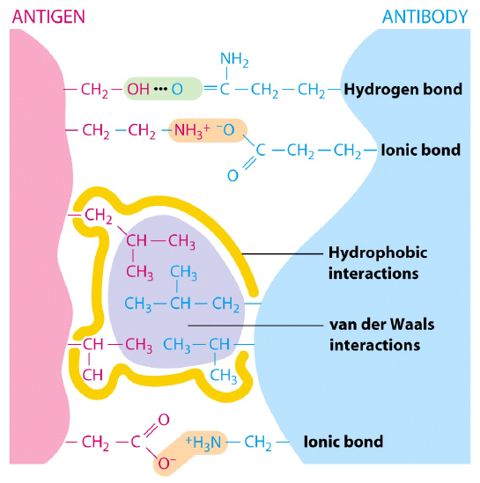
Ag-Ab interactions
Bonds:
Hydrogen
Ionic
Hydrophobic interactions
Van der Waals forces
Each bond is weak; many are strong
To “hold” they must be close → requiring high amounts of complementarity!

Slide 9
Binding of the epitope in the antigen binding site
GOOD FIT
POOR FIT
antibody combining site
antigen determinant
high attraction
high repulsion
low repulsion
low attraction
Notes:
Study Guide
What constitutes a good fit in an antigen binding site?
How does antibody affinity relate to fit?
What are the forces that are attractive and repulsive?
What is actually "fitting" into the combining site?

Slide 10
PRIMARY IMMUNOLOGIC TESTS
IMMUNOASSAYS
Ligand - any substance that will complex to another substance; the substance to be measured.

Slide 11
Affinity – The intensity of interaction between Ag & Ab molecules.
Avidity – The strength of bond after formation of Ag – Ab complexes
Sensitivity – Ability of the test to detect even the minute quantity of Ag or Ab(false –ve absent)
Specificity – Ability of the test to detect rxn between homologous Ag & Ab (false +ve absent)

Slide 12
Serology tests
PRECIPITATION
AGGLUTINATION
COMPLEMENT FIXATION
NEUTRALIZATION

Slide 13
I.PRECIPITATION RXNS
- Antigens involved are soluble antigens.
Types of Precipitation reaction:
1a. Single diffusion, Single Dimension (OUDIN TEST)
Px serum w/ soluble Ag
(+) rxn - formation of pptn line
Gel/Agar impregnated w/ known Ab

Slide 14
1b. Double diffusion, Single Dimension
Oakley – Fulthrope procedure
Antigen added
Plain Gel ( Band formation)
Antibody Gel

Slide 15
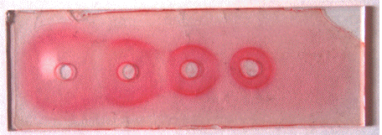
2. Single Diffusion, Double Dimension
(RADIAL IMMUNODIFFUSION)
- uses a plate containing agar with known antibody
- Px serum is placed on the wells
- Diameter of the pptn line is directly proportional to the concentration of the target antigen
*Fahey Mtd (kinetic Diffusion)
*Mancini Mtd (Endpoint Diffusion)

Slide 16
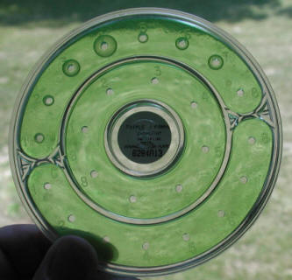
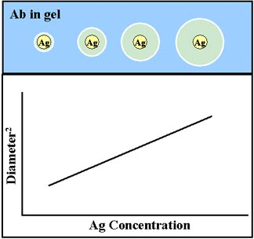

Slide 17
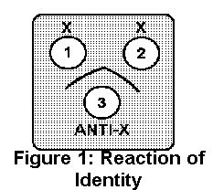
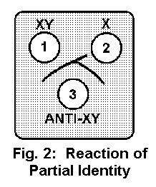
3.Double Diffusion, Double Dimension (OUCHTERLONY TECHNIQUE)
Patterns:
a. Identity - forming smooth curve
- Ag in the sample is same with known Ag
b. Partial Identity - Pptn lines merge with spur formation
- Ag in the sample has some similarities with known Ag

Slide 18
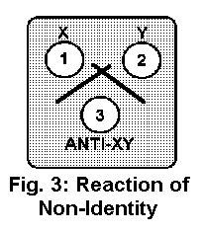
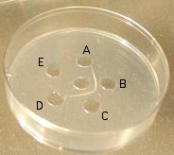
c. Non-Identity - Pptn lines cross/intersect***
Ag in the sample is different from known Ag
Photo of Ouchterlony Test:
Antigens B and C are reactive with the patient's serum in the center well. Antigens A, D, and E are not reactive.

Slide 19
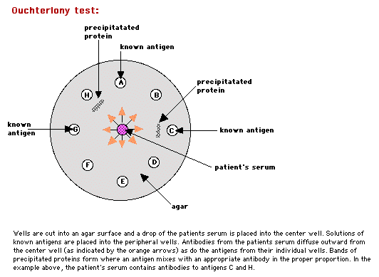

Slide 20
4. CounterImmunoelectrophoresis (CIE)
At pH 8.6,
Ag anode (+) electrode
Ab Cathode (-) electrode
(-) (+)
(+) rxn - Pptn occurring at equivalence
Ag Ab

Slide 21
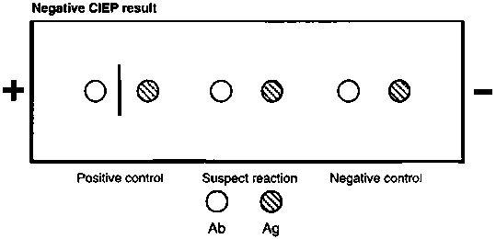
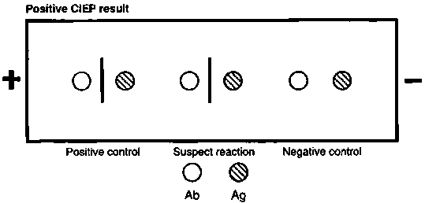
CounterImmunoelectrophoresis (CIE)

Slide 22
5. Immunoelectrophoresis (IEP)
- useful procedure for the ID of monoclonal proteins
(Bence Jones Protein)
- utilizes both double diffusion and electrophoresis
a. Ags migrate under an electric current (-) Ag (+)
b. Rgt. Ab Added. Diffusion through gel (-) (+)
Antibody
c. (+) rxn - Pptn arcs formed (-) (+)

Slide 23
STEP 1.
STEP 2.

Slide 24
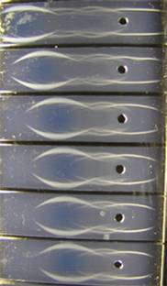
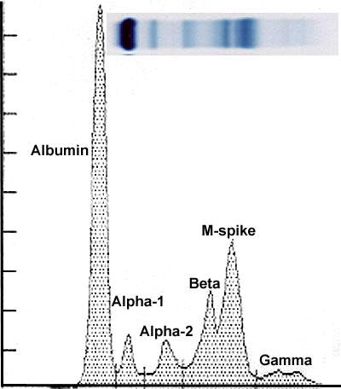
IMMUNOELECTROPHORESIS
VS.
IMMUNOFIXATION

Slide 25
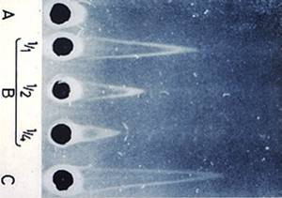
6. Rocket Electrophoresis
(LAURELL TECHNIQUE)
- antiserum is incorporated into the agar and the unknown antigen is placed in the well and electrophoresed
- the total distance of Ag migration and precipitation is directly proportional to Ag concentration.
(-) (+)

Slide 26
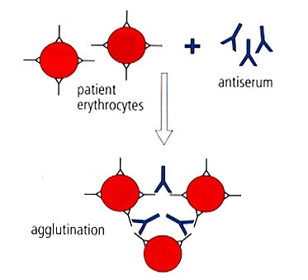
II. AGGLUTINATION REACTIONS
- Ags involved are particulate antigens.
Types of Agglutination Rxn
1.Direct Agglutination (e.g. Blood Typing)

Slide 27
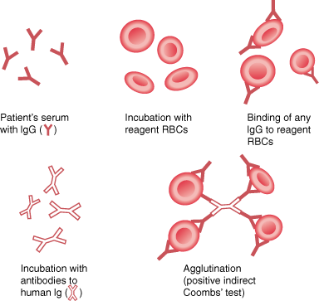
2. Antiglobulin Technique (CoombsTest)/Indirect Agglutination
anti-human IgG is added to bridge the gap between the cells
to demonstrate incomplete antibodies

Slide 28
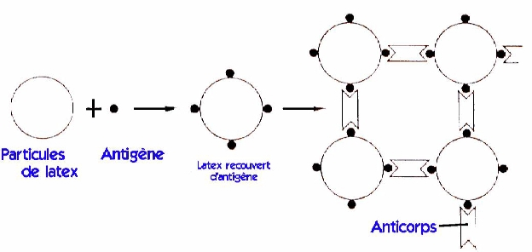
3.Passive Agglutination
- A soluble Ag is artificially attached to a particulate carrier (e.g. cells, latex, bentonite, celloidin, or charcoal

Slide 29
4. Reverse Passive Aggln
- when antibodies are attached to particulate carriers
- Application: CRP, RF determinaton
+

Slide 30
5. Agglutination Inhibition
- Homologous Ag inhibits aggn of Ag coated particle
- 1st step: soluble Ag in px sample + known Ab rgt.
- 2nd step: particulate Ag is added
1ST STEP:
+
PX SAMPLE
RGT: KNOWN ANTISERA
2ND STEP:
POSITIVE RXN:
+
NO AGGLUTINATION
NEGATIVE RXN:
RGT:PARTICULATE ANTIGEN
+
PRESENCE OF
AGGLUTINATION

Slide 31
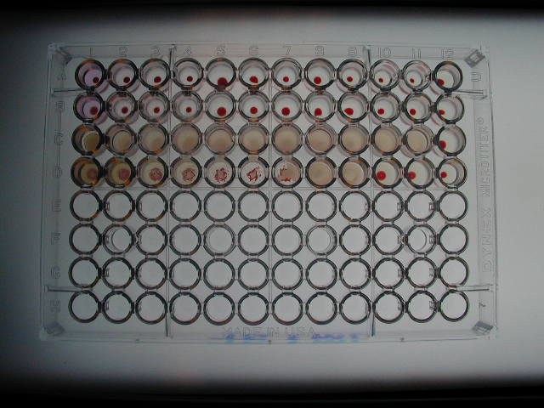
6. Hemagglutination
- Agglutination of RBC due to antibody, viruses, bacteria, or other biologic substance.
- It is not the antigen of RBC but the artificially attached Ag (after undergoing tx) that are made to react with the Ab
- ex. TPHA

Slide 32
III. COMPLEMENT FIXATION
Two systems involved for complement fixation:
1. Test system/Bacteriolytic system
2. Indicator system/Hemolytic system

Slide 33
Components:
a. Known target Ag rgt ( soluble or particulate) (ex. beef heart extract, bacterial Ag)
b. Complement - Best source : Guinea pig serum
c. Hemolysin or Amboceptor - the Ab used to sensitized indicator cells
- Best source: Rabbit antisera to sheep RBC
Indicator cells - Sensitized Sheep RBCs
Antiserum ( inactivated by heating at 56*C)

Slide 34
COMPONENTS OF CF TEST
EX. TPCF
TEST SYSTEM INDICATOR SYSTEM
COMPLEMENT
T.pallidum
antigen rgt.
Sheep RBC rgt.
PX SERUM
Anti-T.pallidum???
Anti-rabbit ab rgt.

Slide 35
PROCEDURE: ex. TPCF
+
+
+
RGT:BACTERIAL Ag
PX SERUM
ANTI-T.pallidum???
RGT: COMPLEMENT
RGT:INDICATOR CELL
POSITIVE REACTION:
+
+
+
TEST SYSTEM FIXES
COMPLEMENT
NO HEMOLYSIS

Slide 36
NEGATIVE REACTION:
+
PX ANTIBODY
NOT PRESENT
+
+
HEMOLYSIS
INDICATOR SYSTEM
FIXES COMPLEMENT

Slide 37
IV.NEUTRALIZATION
- This is the reaction in which the antigenic activity is stopped (neutralized) by its specific antibody.
- Target: To detect toxins, viral agents or Abs to the toxin or viral agents
Types of Neutralization Tests
1. Toxin Neutralization (e.g. Schick Test, Dick Test, ASO TitrationTest)
2. Virus Neutralization

Slide 38
FLUORESCENCE IMMUNOASSAY
Fluorescent Probes used:
a. FITC (Fluorescein isothiocyanate) -emits green light***mostly used
b. Phycocyanin -emits red light
c. Texas red -emits red light
d. Tetramethyl rhodamine -emits red orange light
Techniques:
1. Direct/Single Layer Immunofluorescent Assay
2. Indirect/Double Layer Immunofluorescent Assay

Slide 39
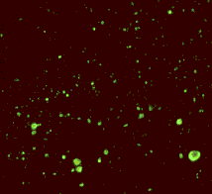
positive FA test for rabies
(Image: Centers for Disease Control)
negative FA test for rabies
(Image: Centers for Disease Control)

Slide 40
B. RADIOIMMUNOASSAY
Radioactive isotopes used:
a. I¹³¹
b. I¹²⁵
c. H³
d. C¹⁴
Techniques:
1. Competitive
2. Non-Competitive

Slide 41
RAST* - Radioallergosorbent test - measures Ag-specific IgE where the ligand is labeled anti-IgE
RIST* - Radioimmunosorbent test - a competitive RIA for total serum IgE
- RIST Activity is indirectly proportional to IgE concentration

Slide 42
ENZYME IMMUNOASSAY
- end rxn: colorimetric reaction
Enzymes Used:
a. ALP
b. Horse raddish Peroxidase
c. Glucose oxidase
d. B-galactosidase
Techniques:
1. Direct
2. Indirect
3. Sandwich/Double Ab
4. Competitive Binding

Slide 43
Types of ELISA – depending on source of antigen -
1st generation ELISA- Ag prepared by propagating viruses in mammalian cell line.
2nd generation ELISA- Ag is derived by bacterial rDNA technology.
3rd generation ELISA- Synthetic peptides used as Ag source.

Slide 44
Indirect ELISA – used for detection of Antibody
Direct ELISA - used for detection of Antigen
Competitive ELISA – for both

Slide 45
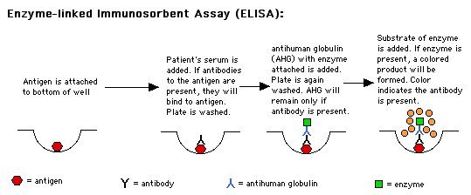

Slide 46
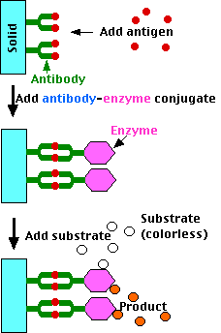
ELISA: DOUBLE ANTIBODY TECHNIQUE

Slide 48
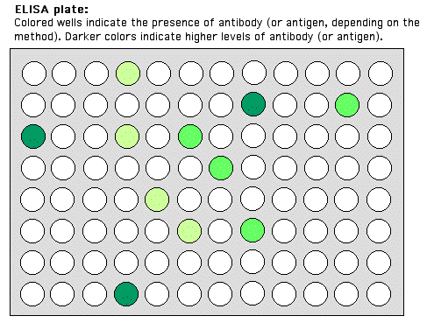

Slide 49
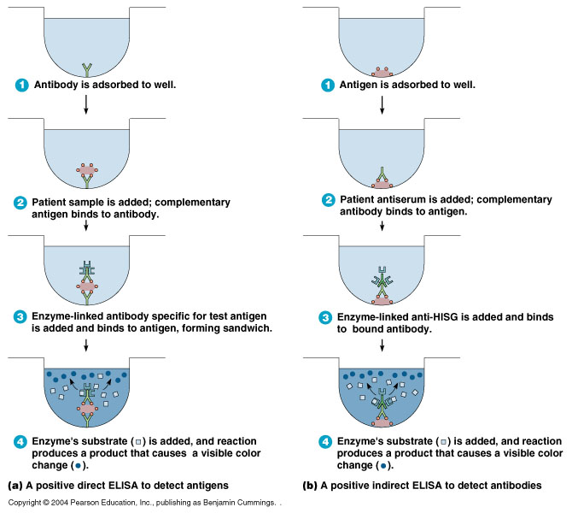

Slide 50
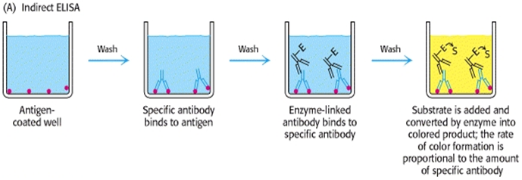

Slide 54
SOL PARTICLE IMMUNOASSAY
- uses colloidal particles in a liquid consisting of metal
or insoluble metal compound as label
Colloidal Particles Used:
a. gold
b. silver
c. silver iodide
d. barium sulfate
Techniques:
1. Homogenous
2. Heterogenous

Slide 55
Teaching Materials slides of main content of the topic to be added and not more than 25 slides for each class should be there.

Slide 56
TAKE HOME MESSEGE/ FOR THE TOPIC COVERED (SUMMARY)
In-Vitro applications of different Antigen – Antibody reactions
Hypothesis behind the reactions
Interpretation of rections

Slide 57
REFERENCES NAME OF THE BOOK WITH EDITION AND PAGE NUMBERS ARTICLE ARE TO BE MENTIONED IF NEEDED

Slide 58
Question & Answer Session
Students should be given opportunity to ask question for clarifying for their understand/ confusions. Teachers must spend 5-10 minutes for this to improve the output.

Slide 59
THANK YOU

